Slide 1
ADAS Integration Challenges & Solutions

Slide 2

Agenda
01
Integration Challenges of ADAS with Different Vehicles
02
Strategies for Effective ADAS Implementation
03
Ensuring Compatibility & Scalability for ADAS Features

Slide 3

01 – Integration Challenges of ADAS with Different Vehicles

Slide 4
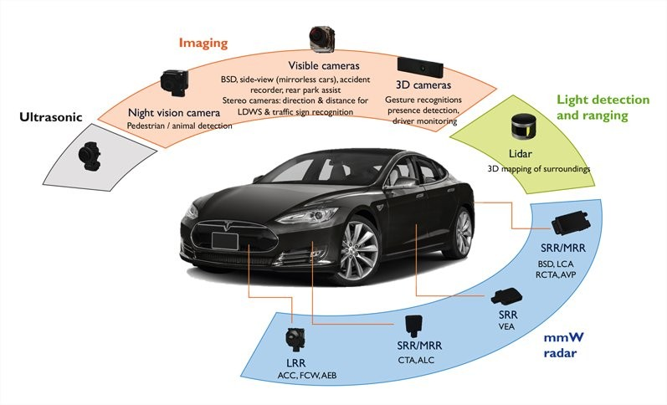
Integration Challenges of ADAS with Different Vehicles
Sensor Integrations
Overview
Definition: Effectively presents challenges due to variations in vehicle design, sensor placement, and underlying software across different vehicle models and manufacturers.
Importance: emphasis on various levels on standardization & ability for repair between different vehicles
Safety & Performance
Driver Experience
Scalability & Cost-Effectiveness
Notes:
Safety and Performance: Proper system calibration and sensor placement are vital for accurate performance of ADAS features like automatic emergency braking or lane departure warning.
Driver Experience: Consistent and intuitive operation across different vehicles builds user trust and reduces confusion when switching between vehicles.
Scalability and Cost-Effectiveness: Standardized integration methods enable manufacturers to efficiently develop and deploy ADAS features across their vehicle portfolios.
Notes:
Hardware Variations:
Sensor placement: The location and configuration of cameras, radars, and LiDARs can differ significantly between vehicles, impacting the effectiveness of ADAS features.
Processing power: The computational demands of ADAS algorithms vary, and vehicles may require different hardware depending on the specific features offered.
Software Challenges:
Calibration and tuning: Each vehicle platform may require unique calibration procedures and software tuning to ensure accurate sensor data interpretation and system performance.
Standardization: A lack of standardized software interfaces between ADAS components and vehicle systems can complicate integration efforts.
Discussion Points:
How can car manufacturers achieve a balance between customization and standardization for ADAS integration across diverse vehicle platforms?
What role can simulation and testing play in overcoming the challenges of ADAS integration with different vehicle types?
How can the automotive industry collaborate to develop open-source platforms that facilitate easier ADAS integration?
References:
https://www.sema.org/news-media/magazine/2022/05/adas-and-art-vehicle-modification
https://www.mckinsey.com/industries/semiconductors/our-insights/advanced-driver-assistance-systems-challenges-and-opportunities-ahead

Slide 5
02 – Strategies for Effective ADAS Implementation

Slide 6
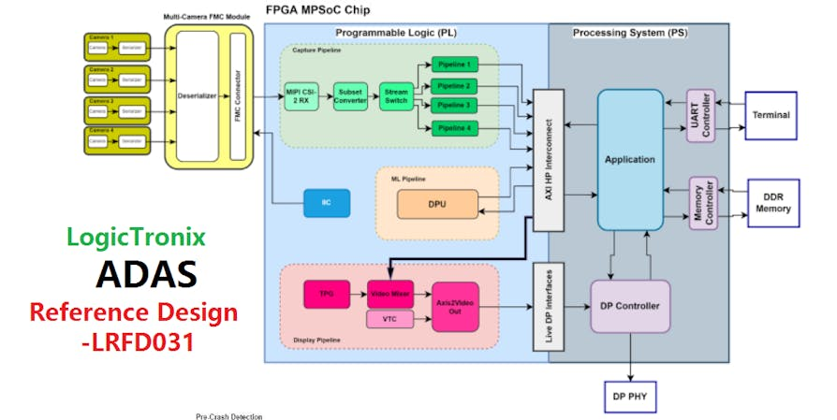
Strategies for Effective ADAS Implementation
Block Diagram of ADAS Reference
Overview
Definition: Implementation requires careful planning, coordination, and execution across various stages.
Importance: assuring quality features are being produced with no critical side effects, ensuring a trustworthy system
Safety & System Performance
User Adoption & Trust
Cost-Effectiveness & Scalability
Notes:
Safety and System Performance: Optimized sensor placement, robust software, and rigorous testing contribute to reliable ADAS functionality.
User Adoption and Trust: Clear communication, intuitive interfaces, and well-designed features encourage driver acceptance and trust in ADAS capabilities.
Cost-Effectiveness and Scalability: Strategic planning helps optimize resource allocation and enables efficient implementation across different vehicle platforms.
Notes:
Planning and System Design:
Clearly define ADAS features and functionalities based on safety priorities and target markets.
Select appropriate sensors and hardware considering vehicle design constraints and processing power requirements.
Design a robust software architecture that facilitates modularity, scalability, and future updates.
Sensor Placement and Calibration:
Strategically position sensors to maximize coverage and minimize blind spots for optimal performance.
Implement thorough calibration procedures to ensure accurate sensor data interpretation.
Software Development and Testing:
Develop robust software algorithms for sensor data processing, decision-making, and system control.
Conduct comprehensive testing across diverse driving scenarios and environmental conditions to validate ADAS performance.
User Interface (UI) and User Experience (UX) Design:
Design intuitive and user-friendly interfaces that clearly communicate ADAS functionality and system status.
Ensure clear and consistent driver feedback mechanisms (visual, auditory) to enhance trust and reduce confusion.
Regulatory Compliance:
Continuously monitor and adapt ADAS features to comply with evolving safety regulations and standards set by governing bodies.
Additional Notes:
Collaboration between car manufacturers, sensor suppliers, and software developers is crucial for successful ADAS implementation.
Cybersecurity measures must be prioritized to protect ADAS systems from hacking and potential malfunctions.
Discussion Points:
How can the trade-off between providing advanced ADAS features and ensuring affordability for consumers be addressed?
What strategies can be employed to educate drivers about ADAS capabilities and limitations, promoting responsible use?
How can ongoing data collection from ADAS systems be leveraged to improve future iterations and enhance safety?
References:
https://www.mckinsey.com/industries/automotive-and-assembly/our-insights/autonomous-drivings-future-convenient-and-connected
https://www.mckinsey.com/industries/semiconductors/our-insights/advanced-driver-assistance-systems-challenges-and-opportunities-ahead

Slide 8
03 – Ensuring Compatibility & Scalability for ADAS Features

Slide 9
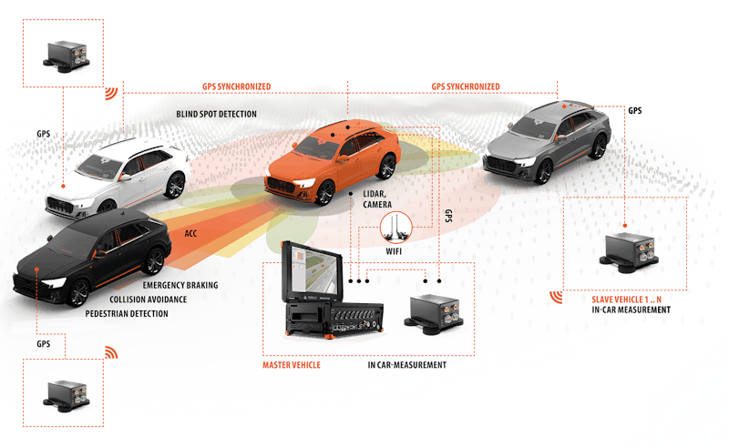
Ensuring Compatibility & Scalability for ADAS Features
Vehicle Interactions
Overview
Definition: Seamless integration of ADAS features with various vehicle hardware and software systems for the efficient adaptation and deployment
Importance: ensuring they function effectively across a range of vehicle models and platforms
Standardized Functionality
Platform Flexibility
Market Reach & Future Growth
Notes:
Standardized Functionality: Compatible ADAS features deliver consistent performance regardless of the vehicle, fostering user trust and reducing confusion.
Platform Flexibility: Scalable ADAS systems can be efficiently adapted to different vehicle types and configurations, reducing development costs and expediting time-to-market.
Market Reach and Future Growth: Compatibility and scalability enable manufacturers to offer ADAS features across their product lines, catering to a wider audience and supporting future advancements.
Notes:
Hardware Compatibility:
Modular sensor design: Utilize modular sensor configurations that can be adapted to different vehicle layouts while maintaining core functionalities.
Standardized interfaces: Promote the adoption of standardized interfaces for sensor communication with vehicle ECUs (Electronic Control Units) to ensure seamless integration.
Software Scalability:
Modular software architecture: Develop ADAS software with a modular architecture, allowing for feature subsets to be enabled or disabled based on vehicle configuration.
Scalable algorithms: Design algorithms that can be efficiently scaled to accommodate different processing power capabilities of various vehicle platforms.
Calibration and Validation Strategies:
Automated calibration tools: Implement automated calibration tools that can adapt to different sensor placements across vehicle models.
Virtual testing environments: Leverage virtual testing environments to validate ADAS performance across diverse vehicle configurations.
Additional Notes:
Open communication and collaboration among car manufacturers, sensor suppliers, and software developers are essential for achieving compatibility and scalability goals.
Adherence to industry standards for ADAS functionalities and interfaces promotes compatibility across different vehicle platforms.
Discussion Points:
How can the automotive industry balance the need for customization with the benefits of standardized ADAS features?
What role can simulation tools play in ensuring compatibility and scalability of ADAS features across different vehicle platforms?
How can future developments in software architecture and artificial intelligence contribute to more scalable and adaptable ADAS systems?
References:
https://www.mckinsey.com/industries/automotive-and-assembly/our-insights/autonomous-drivings-future-convenient-and-connected
https://www.sema.org/news-media/magazine/2022/05/adas-and-art-vehicle-modification

Slide 10
Thank You!

